Slide 1
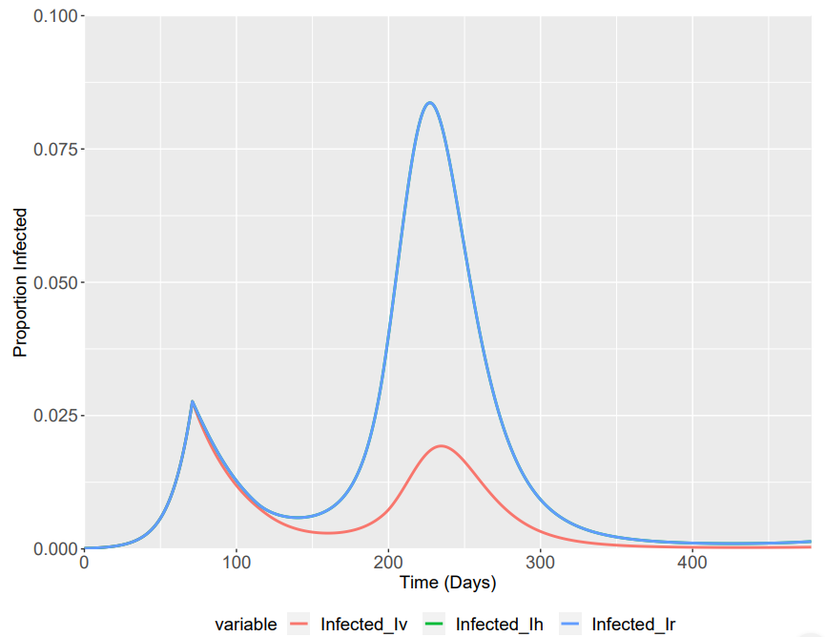
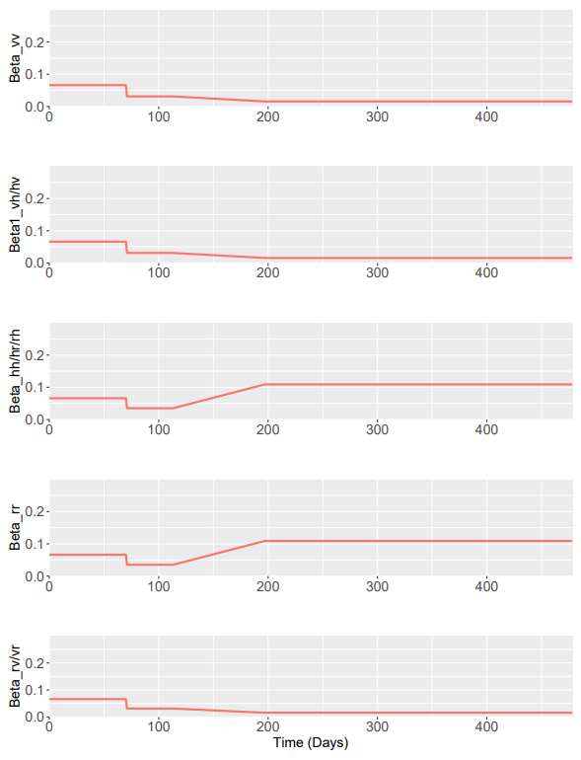
Phase 2
Phase 4
Central Scenario
Betas | Central
β1 | 0.8
β2 | 0.9
β3 | 0.9
Betas | Central
β1 | 0.4 (Enhanced Shielding)
β2 | 2.8
β3 | 2.8

